Slide 1
The Future of Blockchain
By Paras Dalal

Slide 2
What Do I Plan to Cover
Problems that we want to solve
General concept of Blockchain
Overview of How it is implemented
Common uses of Blockchain
Problems of Blockchain
Possible future uses
Is it relevant to Bessemer

Slide 3
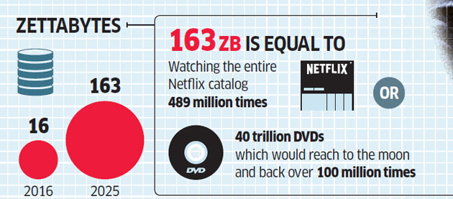
Problems that we want to solve
Data Overflow
1,000,000,000,000,000,000,000 (10²¹ = 1 Billion Terabytes)

Slide 4

Problems that we want to solve
Data Security

Slide 5
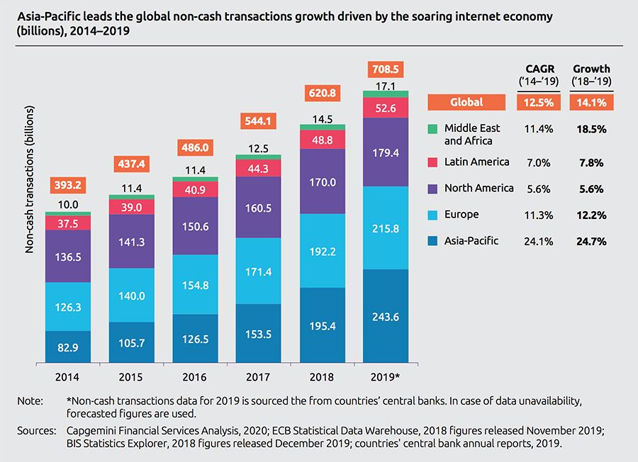
Problems that we want to solve
Transactions

Slide 6
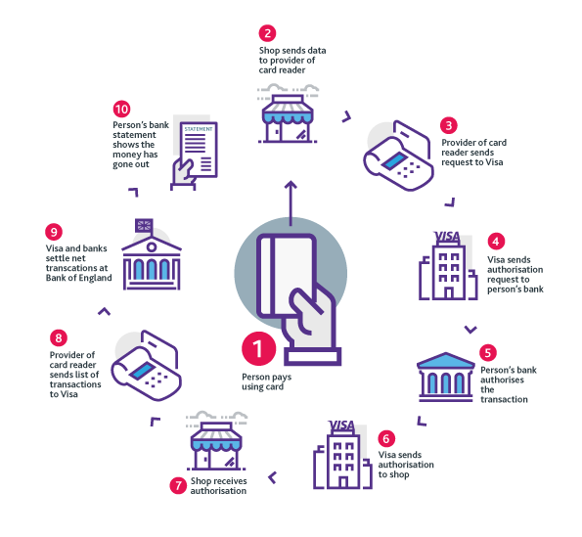
Problems that we want to solve
Intermediaries

Slide 7
Problems that we want to solve
Intermediaries

Slide 8
General concept of Blockchain

Slide 9
Overview of How it is implemented
Decentralized environment

Slide 10
Common uses of Blockchain

Slide 11
Problems of Blockchain

Slide 12
Possible future uses

Slide 13
Is it relevant to Bessemer

